Slide 1
Scaled Agile Overview
Prepared by:
Ritesh Mandlik

Slide 2
Agenda
Brief Overview
Example of Scaled Agile
PSI Planning
Relative Sizing
Estimation Board
Team determines Capacity/Commitments
PSI Plan
Team Train Interaction & Dependencies
Agile Hierarchy

Slide 3
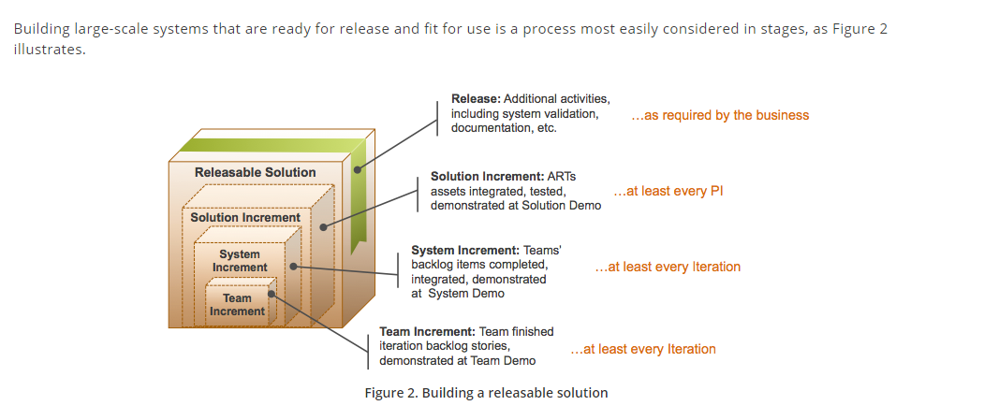
Brief Overview
The goal of scaled agile is frequent delivery of valuable, working and fully tested increments of solution.

Slide 4
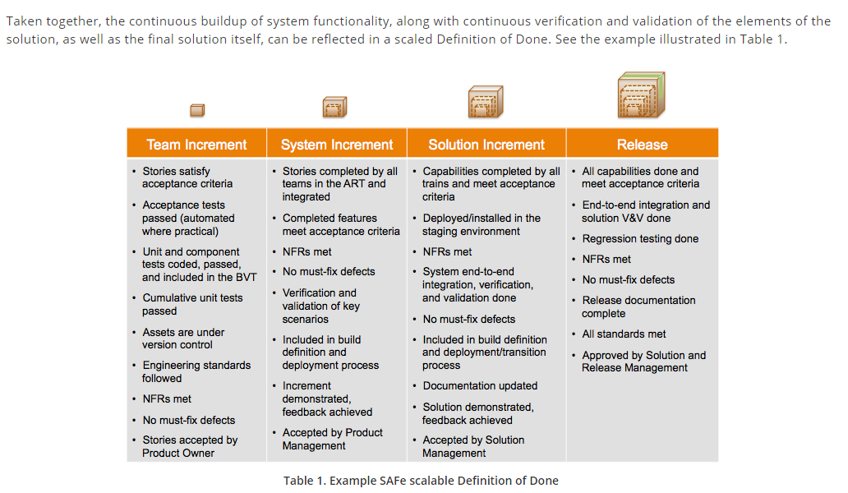
Example of Scaled Agile Methodology

Slide 5
PSI Planning
PSI Planning
Planning event scheduled few days before PSI
Relative sizing of stories (Estimation Board)
Team determines Capacity and Commitment (Data Sheet; PSI Plan)
Use Historical Data
Do Not Overcommit
Fist of Five
Team commits to deliverables at PSI level
Team level grooming and stand-up
Team level retrospectives

Slide 6
First Day in PSI Planning
Welcome
Spot Light Topic
Release Vision
It is review of Objectives by team
what is being asked for and the need it will meet.

Slide 7
Second Day in PSI Planning
Planning
Collaborating (Scrum of Scrums)
PSI Level Commitment by Team

Slide 8
Relative Sizing
All team members participate in defining the size of the story.
Rally provides a tool (Estimation Board) to enable this activity.

Slide 9
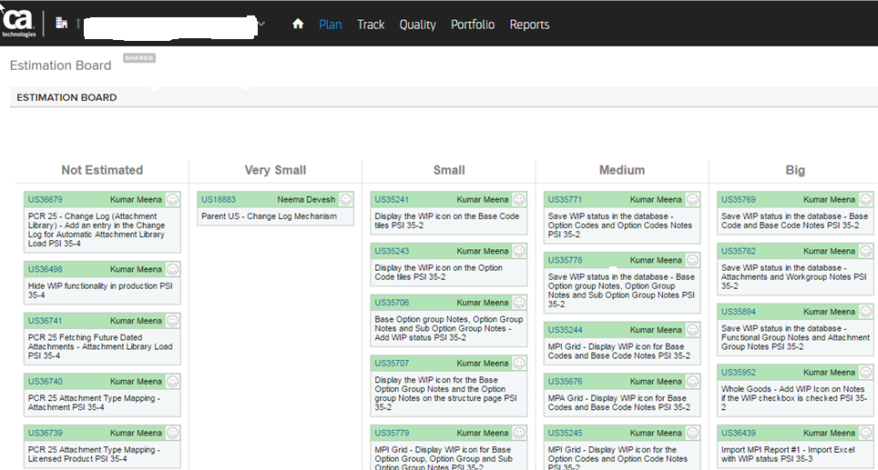
Estimation Board

Slide 10
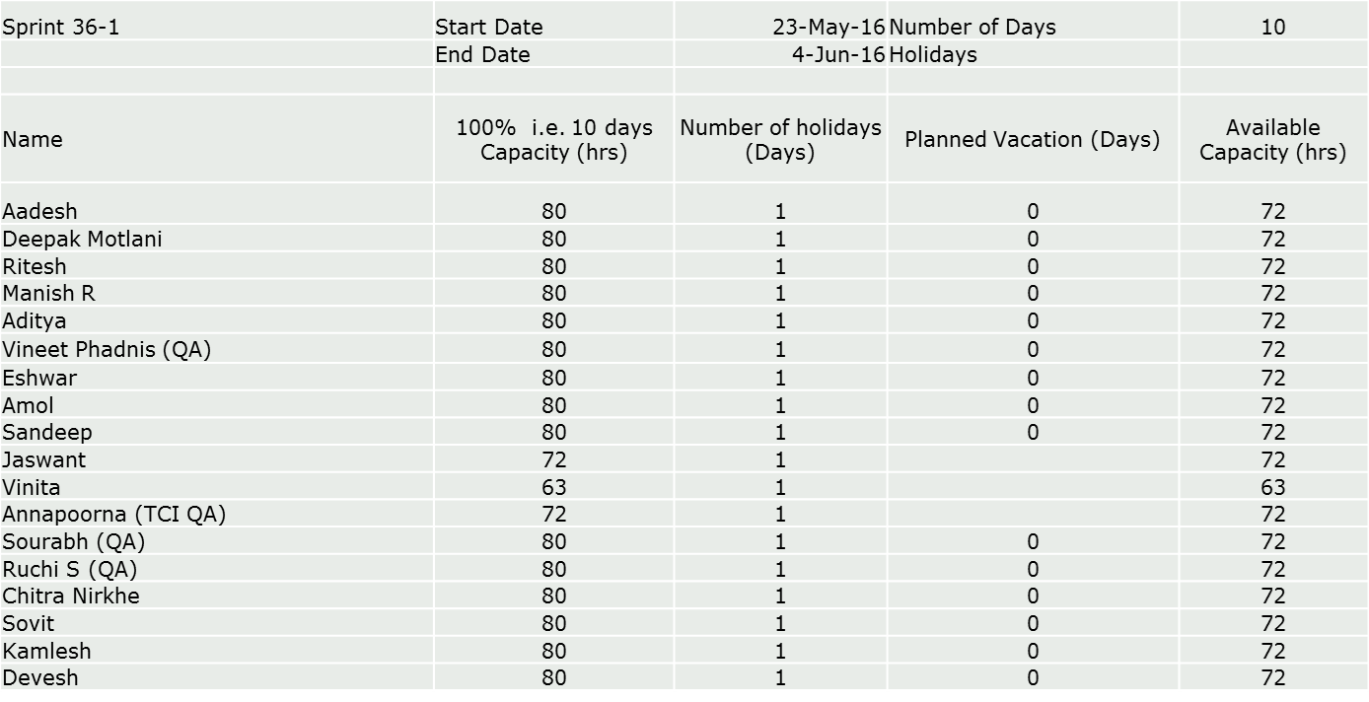
Team Determines Capacity/Commitments
First step of planning is to review team member capacity
Team Capacity Calculation

Slide 11
Team Determines Capacity/Commitments
Capacity Allocation
Second step is for team to agree on how they will allocate their known capacity
Example:
Team A has 500 hours of capacity in Sprint 36-1
User Stories= 70% (approximately 70 points)
Defects=10%
Grooming=15%
Other?= 5%

Slide 12
Team Determines Capacity/Commitments
User Story Allocation considering Capacity
Third step is to allocate stories to sprints, until Capacity is reached.
Utilize the PSI Plan board inside Rally
After each sprint is populated, team takes final “vote” using Fist of Five.
What is Fist of Five:
ensures alignment across Team
ALL team members are required to participate
Confidence of 4 or above by all team members is required for commitment.

Slide 13
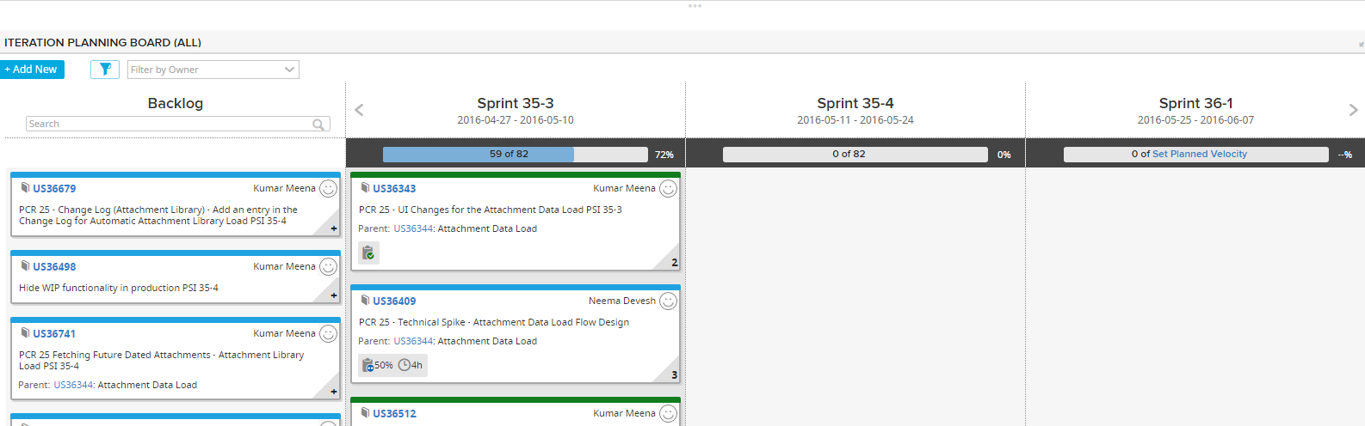
PSI Plan

Slide 14
Planning Completion Activity
PO Report Out
Objectives Slide
What’s IN
What’s OUT
Dependencies
Risks
DO - SAY ratio review for prior PSI (begins with Current PSI)%
Example:
Said we would do 20 stories
Did 15 stories
75% Do – Say

Slide 15
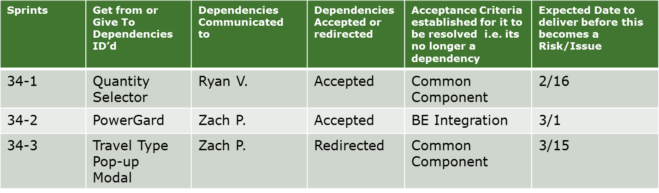
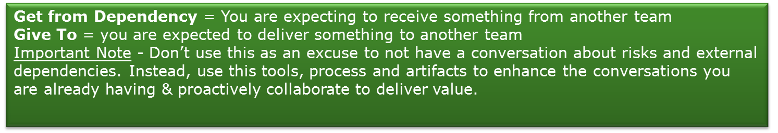
Team/Train Interactions & Dependencies

Slide 16
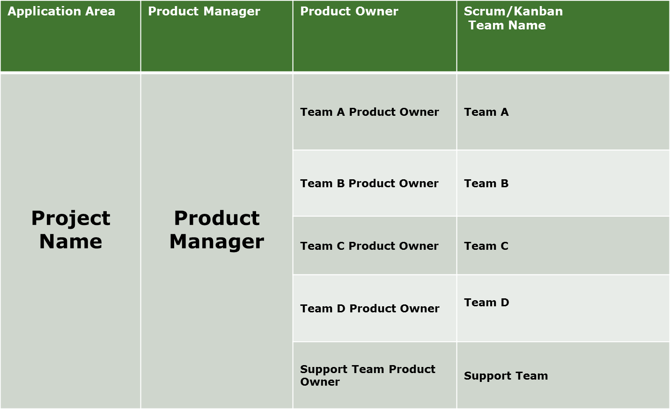
Agile Structure

Slide 17
Thank you!

